Slide 1
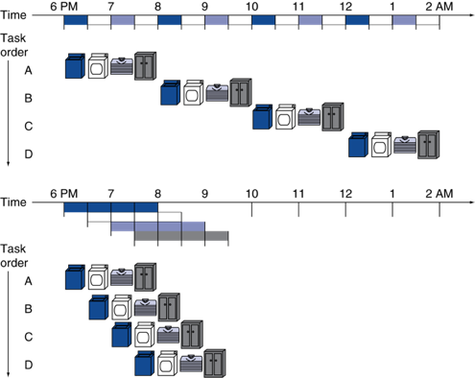
Separate resource for each stage
Speedup:
Four loads: 8/3.5 = 2.3
Non-stop: approaches 4

Slide 2
Example Problem 1
A single cycle processor with a cycle time of 1000 ps split into a 5 staged pipelined processor with a cycle time of 250 ps.
How long does it take an instruction to execute in the pipelined processor?
What is the speedup for executing 5 instructions?
What would the speedup be for an infinite number of instructions?

Slide 3
A single cycle processor with a cycle time of 1000 ps split into a 5 staged pipelined processor with a cycle time of 250 ps.
How long does it take an instruction to execute in the pipelined processor? 250x5 = 1250 ps
What is the speedup for executing 5 instructions?
5 instructions single cycle = 1000x5 = 5000 ps
5 instructions pipeline = 1250 + 250*4 = 2250 ps (1250 for the first instruction, after that, an instruction completes every 250 ps)
Speedup = 5000/2250 = 2.22

Slide 4
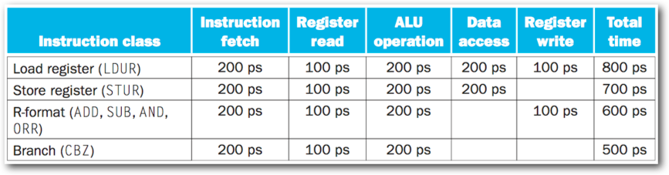
What would the cycle time be for a single cycle processor?

Slide 5
Example Problem 2 Step 2
What would the cycle time be for a single cycle processor? 800 ps, the longest time required by an instruction

Slide 6
Example Problem 2 Step 3
What would the cycle time be for a single cycle processor? 800 ps, the longest time required by an instruction
What would the cycle time be for a pipelined processor?

Slide 7
Example Problem 2 Step 4
What would the cycle time be for a single cycle processor? 800 ps, the longest time required by an instruction
What would the cycle time be for a pipelined processor? 200 ps, the longest time required in a stage

Slide 8
Example Problem 2 Step 5
What would the cycle time be for a single cycle processor? 800 ps, the longest time required by an instruction
What would the cycle time be for a pipelined processor? 200 ps, the longest time required in a stage
How long does one instruction take to get through the pipelined processor?

Slide 9
Example Problem 2 Step 6
What would the cycle time be for a single cycle processor? 800 ps, the longest time required by an instruction
What would the cycle time be for a pipelined processor? 200 ps, the longest time required in a stage
How long does one instruction take to get through the pipelined processor? 200*5 = 1000 ps

Slide 10
Example Problem 2 Step 7
What would the cycle time be for a single cycle processor? 800 ps, the longest time required by an instruction
What would the cycle time be for a pipelined processor? 200 ps, the longest time required in a stage
How long does one instruction take to get through the pipelined processor? 200*5 = 1000 ps
What is the speedup of the pipeline processor compared to the single cycle processor when executing 10 instructions?

Slide 11
Example Problem 2 Step 8
What would the cycle time be for a single cycle processor? 800 ps, the longest time required by an instruction
What would the cycle time be for a pipelined processor? 200 ps, the longest time required in a stage
How long does one instruction take to get through the pipelined processor? 200*5 = 1000 ps
What is the speedup of the pipeline processor compared to the single cycle processor when executing 10 instructions? Single cycle time: 800*10 = 8000 ps
Pipelined time: 1000 + 9*200 = 2800 ps
Speedup = 8000/2800 = 2.85

Slide 12
Which control signals are forwarded to the EX stage?

Slide 13
Which control signals are forwarded to the EX stage? ALUrc, ALUOp
Which control signals are forwarded to the Memory stage?

Slide 14
Which control signals are forwarded to the EX stage? ALUrc, ALUOp
Which control signals are forwarded to the Memory stage? Branch, MemWrite, MemRead
Which control signals are forwarded to the WriteBack stage?

Slide 15
Which control signals are forwarded to the EX stage? ALUrc, ALUOp
Which control signals are forwarded to the Memory stage? Branch, MemWrite, MemRead
Which control signals are forwarded to the WriteBack stage? MemtoReg, RegWrite

Slide 16
Hazards
Cause the instruction to not be able to execute
Structural hazard
Two instructions need the same hardware in the same cycle
Data hazard
An instruction needs data from a register before it has been calculated
Control hazard
Which instruction to fetch is unknown because the result of a branch decision is not known yet

Slide 17
Bottom Line….
Structural hazards are taken care of in the design of our simple data path….

Slide 18
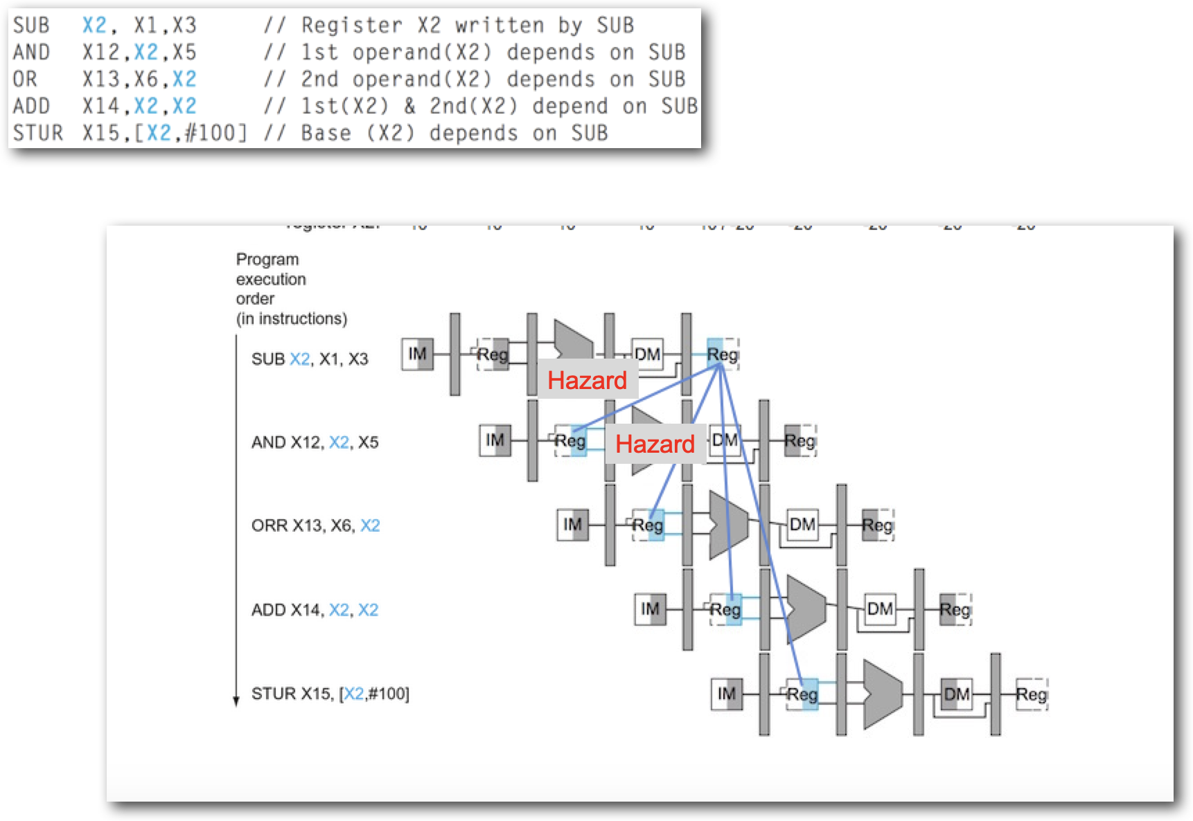
Data Hazards

Slide 19
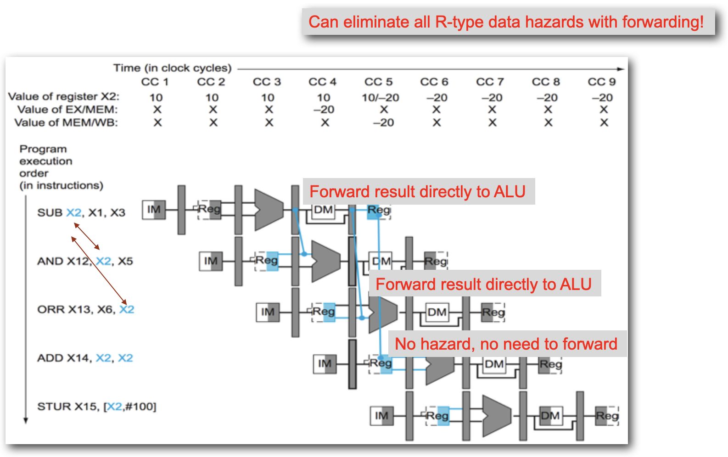
Except R-type followed by CBZ (more on that later….)

Slide 20
Load-Use Hazard
Key point: For our simple datapath, the only data hazard that can’t be taken care of with forwarding is a load followed by an instruction that uses the register being loaded.
And a branch that follows an instruction that loads the value being evaluated. (Stay Tuned)

Slide 21
Example Problem 4 Step 1
Trace the execution of the following instructions through the pipeline
LDUR X19, [X10, #0]
ADD X9, X9, X10
SUB X12, X10, X9
SUB X12, X12, X19
LDUR X13, [X20, #8]
ADD X9, X9, X13

Slide 22
Example Problem 4 Step 2
Trace the execution of the following instructions through the pipeline
LDUR X19, [X10, #0]
ADD X9, X9, X10
SUB X12, X10, X9
SUB X12, X12, X19
LDUR X13, [X20, #8]
ADD X9, X9, X13
Not a hazard, X19 is not being used in the next instruction, X10 does not get a new value

Slide 23
Example Problem 4 Step 3
Trace the execution of the following instructions through the pipeline
LDUR X19, [X10, #0]
ADD X9, X9, X10
SUB X12, X10, X9
SUB X12, X12, X19
LDUR X13, [X20, #8]
ADD X9, X9, X13
Not a hazard, X19 has been updated by the time this SUB instruction needs it

Slide 24
Example Problem 4 Step 4
Trace the execution of the following instructions through the pipeline
LDUR X19, [X10, #0]
ADD X9, X9, X10
SUB X12, X10, X9
SUB X12, X12, X19
LDUR X13, [X20, #8]
ADD X9, X9, X13
Forwarding takes care of updating X9 before the first SUB needs it, and updating X12 before the second SUB needs it

Slide 25
Example Problem 4 Step 5
Trace the execution of the following instructions through the pipeline
LDUR X19, [X10, #0]
ADD X9, X9, X10
SUB X12, X10, X9
SUB X12, X12, X19
LDUR X13, [X20, #8]
ADD X9, X9, X13
This is a hazard. We will have to insert a stall so that ADD can wait for the value from memory to be loaded

Slide 26
Example Problem 5 Step 1
Trace the execution of the following instructions through the pipeline
LDUR X19, [X10, #0]
ADD X9, X9, X10
SUB X12, X10, X9
SUB X12, X12, X19
LDUR X13, [X20, #8]
ADD X9, X9, X13
Cycle | IF | ID / Register Read | ALU | Memory | Write Back
1
2
3
4
5
6
7
8
9
10
11

Slide 27
Example Problem 5 Step 2
Trace the execution of the following instructions through the pipeline
LDUR X19, [X10, #0]
ADD X9, X9, X10
SUB X12, X10, X9
SUB X12, X12, X19
LDUR X13, [X20, #8]
ADD X9, X9, X13
Cycle | IF | ID / Register Read | ALU | Memory | Write Back
1 | LDUR X19, [X10, #0]
2 | ADD X9, X9, X10 | LDUR X19, [X10, #0]
3 | SUB X12, X10, X9 | ADD X9, X9, X10 | LDUR X19, [X10, #0]
4 | SUB X12, X12, X19 | SUB X12, X10, X9 | ADD X9, X9, X10 | LDUR X19, [X10, #0]
5 | LDUR X13, [X20, #8] | SUB X12, X12, X19 | SUB X12, X10, X9 | ADD X9, X9, X10 | LDUR X19, [X10, #0]
6 | ADD X9, X9, X13 | LDUR X13, [X20, #8] | SUB X12, X12, X19 | SUB X12, X10, X9 | ADD X9, X9, X10
7 |  | ADD X9, X9, X13 | LDUR X13, [X20, #8] | SUB X12, X12, X19 | SUB X12, X10, X9
8 |  | ADD X9, X9, X13 | Stall / nop | LDUR X13, [X20, #8] | SUB X12, X12, X19
9 |  |  | ADD X9, X9, X13 | Stall / nop | LDUR X13, [X20, #8]
10 |  |  |  | ADD X9, X9, X13 | Stall / nop
11 |  |  |  |  | ADD X9, X9, X13

Slide 28
34 - Diagram

Slide 29
Move the branch checking calculation to the ID stage

Slide 30
Still have one cycle in which we don’t know what instruction to fetch
CBZ

Slide 31
Solution: branch prediction. Make a guess, if the guess was wrong flush the instruction and load the correct instruction in the next cycle
CBZ

Slide 32
Example Problem 5 Step 1
Trace the execution of the following instructions through the pipeline. For branch prediction, assume the branch is not taken.
X9 evaluates to zero.
ADD X9, XZR, XZR
LDUR X10, [X19, #0]
CBZ X9, Label
SUB X12, X10, X9
SUB X12, X12, X19
LDUR X13, [X20, #8]
Label: ADD X9, X9, X13
Cycle | IF | ID / Register Read | ALU | Memory | Write Back
1
2
3
4
5
6
7
8
9
10
11

Slide 33
Example Problem 5 Step 2
Trace the execution of the following instructions through the pipeline. For branch prediction, assume the branch is not taken.
X9 evaluates to zero.
ADD X9, XZR, XZR
LDUR X10, [X19, #0]
CBZ X9, Label
SUB X12, X10, X9
SUB X12, X12, X19
LDUR X13, [X20, #8]
Label: ADD X9, X9, X13
Cycle | IF | ID / Register Read | ALU | Memory | Write Back
1 | ADD X9, XZR, XZR
2 | LDUR X10, [X19, #0] | ADD X9, XZR, XZR
3 | CBZ X9, Label | LDUR X10, [X19, #0] | ADD X9, XZR, XZR
4 | SUB X12, X10, X9 | CBZ X9, Label | LDUR X10, [X19, #0] | ADD X9, XZR, XZR
5
6
7
8
9
10
11

Slide 34
Example Problem 5 Step 3
Trace the execution of the following instructions through the pipeline. For branch prediction, assume the branch is not taken.
X9 evaluates to zero.
ADD X9, XZR, XZR
LDUR X10, [X19, #0]
CBZ X9, Label
SUB X12, X10, X9
SUB X12, X12, X19
LDUR X13, [X20, #8]
Label: ADD X9, X9, X13
Cycle | IF | ID / Register Read | ALU | Memory | Write Back
1 | ADD X9, XZR, XZR
2 | LDUR X10, [X19, #0] | ADD X9, XZR, XZR
3 | CBZ X9, Label | LDUR X10, [X19, #0] | ADD X9, XZR, XZR
4 | SUB X12, X10, X9 | CBZ X9, Label | LDUR X10, [X19, #0] | ADD X9, XZR, XZR
5 | ADD X9, X9, X13 | flush / nop | CBZ X9, Label | LDUR X10, [X19, #0] | ADD X9, XZR, XZR
6 |  | ADD X9, X9, X13 | flush / nop | CBZ X9, Label | LDUR X10, [X19, #0]
7 |  |  | ADD X9, X9, X13 | flush / nop | CBZ X9, Label
8 |  |  |  | ADD X9, X9, X13 | flush / nop
9 |  |  |  |  | ADD X9, X9, X13
10
11

Slide 35
Data Hazards Involving CBZ

Slide 36
Data Hazards Involving CBZ

Slide 37
Trace the execution of the following instructions through the pipeline. For branch prediction, assume the branch is not taken.
X9 evaluates to zero.
SUB X9, X9, X8
CBZ X9, Label
SUB X12, X10, X9
SUB X12, X12, X19
LDUR X13, [X20, #8]
Label: ADD X9, X9, X13
Cycle | IF | ID / Register Read | ALU | Memory | Write Back
1
2
3
4
5
6
7
8
9
10
11

Slide 38
Trace the execution of the following instructions through the pipeline. For branch prediction, assume the branch is not taken.
X9 evaluates to zero.
SUB X9, X9, X8
CBZ X9, Label
SUB X12, X10, X9
SUB X12, X12, X19
LDUR X13, [X20, #8]
Label: ADD X9, X9, X13
Cycle | IF | ID / Register Read | ALU | Memory | Write Back
1 | SUB X9, X9, X8
2 | CBZ X9, Label | SUB X9, X9, X8
3 | SUB X12, X10, X9 | CBZ X9, Label | SUB X9, X9, X8
4 | SUB X12, X10, X9 | CBZ X9, Label | Stall / nop | SUB X9, X9, X8
5
6
7
8
9
10
11

Slide 39
Trace the execution of the following instructions through the pipeline. For branch prediction, assume the branch is not taken.
X9 evaluates to zero.
SUB X9, X9, X8
CBZ X9, Label
SUB X12, X10, X9
SUB X12, X12, X19
LDUR X13, [X20, #8]
Label: ADD X9, X9, X13
Cycle | IF | ID / Register Read | ALU | Memory | Write Back
1 | SUB X9, X9, X8
2 | CBZ X9, Label | SUB X9, X9, X8
3 | SUB X12, X10, X9 | CBZ X9, Label | SUB X9, X9, X8
4 | SUB X12, X10, X9 | CBZ X9, Label | Stall / nop | SUB X9, X9, X8
5 | ADD X9, X9, X13 | Flush / nop | CBZ X9, Label | Stall / nop | SUB X9, X9, X8
6 |  | ADD X9, X9, X13 | Flush / nop | CBZ X9, Label | Stall / nop
7 |  |  | ADD X9, X9, X13 | Flush / nop | CBZ X9, Label
8 |  |  |  | ADD X9, X9, X13 | Flush / nop
9 |  |  |  |  | ADD X9, X9, X13
10
11

Slide 40
Trace the execution of the following instructions through the pipeline. For branch prediction, assume the branch is not taken.
X9 evaluates to zero.
LDUR X9, [X20]
CBZ X9, Label
SUB X12, X10, X9
SUB X12, X12, X19
LDUR X13, [X20, #8]
Label: ADD X9, X9, X13
Cycle | IF | ID / Register Read | ALU | Memory | Write Back
1
2
3
4
5
6
7
8
9
10
11

Slide 41
Trace the execution of the following instructions through the pipeline. For branch prediction, assume the branch is not taken.
X9 evaluates to zero.
LDUR X9, [X20]
CBZ X9, Label
SUB X12, X10, X9
SUB X12, X12, X19
LDUR X13, [X20, #8]
Label: ADD X9, X9, X13
Cycle | IF | ID / Register Read | ALU | Memory | Write Back
1 | LDUR X9, [X20]
2 | CBZ X9, Label | LDUR X9, [X20]
3 | SUB X12, X10, X9 | CBZ X9, Label | LDUR X9, [X20]
4 | SUB X12, X10, X9 | CBZ X9, Label | stall | LDUR X9, [X20]
5 | SUB X12, X10, X9 | CBZ X9, Label | stall | stall | LDUR X9, [X20]
6 | ADD X9, X9, X13 | flush | CBZ X9, Label | stall | stall
7 |  | ADD X9, X9, X13 | flush | CBZ X9, Label | stall
8 |  |  | ADD X9, X9, X13 | flush | CBZ X9, Label
9 |  |  |  | ADD X9, X9, X13 | flush
10 |  |  |  |  | ADD X9, X9, X13
11

Slide 42
Trace the execution of the following instructions through the pipeline. For branch prediction, assume the branch is not taken.
X9 evaluates to 1.
LDUR X10, [X19, #0]
CBZ X9, Label
SUB X12, X10, X9
ADD X12, X12, X19
LDUR X13, [X20, #8]
Label: AND X9, X9, X13
Cycle | IF | ID / Register Read | ALU | Memory | Write Back
1
2
3
4
5
6
7
8
9
10
11

Slide 43
Trace the execution of the following instructions through the pipeline. For branch prediction, assume the branch is not taken.
X9 evaluates to 1.
LDUR X10, [X19, #0]
CBZ X9, Label
SUB X12, X10, X9
ADD X12, X12, X19
LDUR X13, [X20, #8]
Label: AND X9, X9, X13
Cycle | IF | ID / Register Read | ALU | Memory | Write Back
1 | LDUR X10, [X19, #0]
2 | CBZ X9, Label | LDUR X10, [X19, #0]
3 | SUB X12, X10, X9 | CBZ X9, Label | LDUR X10, [X19, #0]
4 | ADD X12, X12, X19 | SUB X12, X10, X9 | CBZ X9, Label | LDUR X10, [X19, #0]
5 | LDUR X13, [X20, #8] | ADD X12, X12, X19 | SUB X12, X10, X9 | CBZ X9, Label | LDUR X10, [X19, #0]
6 | AND X9, X9, X13 | LDUR X13, [X20, #8] | ADD X12, X12, X19 | SUB X12, X10, X9 | CBZ X9, Label
7 |  | AND X9, X9, X13 | LDUR X13, [X20, #8] | ADD X12, X12, X19 | SUB X12, X10, X9
8 |  | AND X9, X9, X13 | stall | LDUR X13, [X20, #8] | ADD X12, X12, X19
9 |  |  | AND X9, X9, X13 | stall | LDUR X13, [X20, #8]
10 |  |  |  | AND X9, X9, X13 | stall
11 |  |  |  |  | AND X9, X9, X13

Slide 44
Static Branch Prediction
At compile time
Some options
Always not taken
Always taken
Backward branches always taken, forward branches always not taken

Slide 45
Which instructions will be stalled because of a data hazard?
LDUR X9, [X20]
ADD X20, X20, #1
ADD X10, X20, #1
LDUR X10, [X20]
ADD X10, X10, #1
CBZ X10, #4
LDUR X10, [X20]
CBZ X10, #2
ADD X10, X10, #1
BL Printf
exit: MOV x0, 0 MOV x8, 93 SVC 0 BR X30

Slide 46
Example Problem 9 Step 2
Which instructions will be stalled because of a data hazard?
LDUR X9, [X20]
ADD X20, X20, #1
ADD X10, X20, #1
LDUR X10, [X20]
ADD X10, X10, #1
CBZ X10, #4
LDUR X10, [X20]
CBZ X10, #2
ADD X10, X10, #1
BL Printf
exit: MOV x0, 0 MOV x8, 93 SVC 0 BR X30
Load-use hazard

Slide 47
Example Problem 9 Step 3
Which instructions will be stalled because of a data hazard?
LDUR X9, [X20]
ADD X20, X20, #1
ADD X10, X20, #1
LDUR X10, [X20]
ADD X10, X10, #1
CBZ X10, #4
LDUR X10, [X20]
CBZ X10, #2
ADD X10, X10, #1
BL Printf
exit: MOV x0, 0 MOV x8, 93 SVC 0 BR X30
Data hazard with branch decided in fetch stage, X10 not known yet

Slide 48
Example Problem 9 Step 4
Which instructions will be stalled because of a data hazard?
LDUR X9, [X20]
ADD X20, X20, #1
ADD X10, X20, #1
LDUR X10, [X20]
ADD X10, X10, #1
CBZ X10, #4
LDUR X10, [X20]
CBZ X10, #2
ADD X10, X10, #1
BL Printf
exit: MOV x0, 0 MOV x8, 93 SVC 0 BR X30
Data hazard with branch decided in fetch stage, X10 not known yet

Slide 49
Forward Loop Branch Prediction
MOV X10, #10
Loop: CBZ X10, LoopExit
SUB X10, X10, #1
B Loop
LoopExit:
What is the accuracy of an “assume branch not taken” predictor?

Slide 50
Forward Loop Branch Prediction
MOV X10, #10
Loop: CBZ X10, LoopExit
SUB X10, X10, #1
B Loop
LoopExit:
What is the accuracy of an “assume branch not taken” predictor?
On the 11th iteration, X10 contains zero
10/11 = 0.909

Slide 51
Backward Loop Branch Prediction
MOV X10, #10
Loop: SUB X10, X10, #1
CBNZ X10, Loop
What is the accuracy of an “assume branch taken” predictor?

Slide 52
Backward Loop Branch Prediction
MOV X10, #10
Loop: SUB X10, X10, #1
CBNZ X10, Loop
What is the accuracy of an “assume branch taken” predictor?
On the 10th iteration, X10 is zero
9/10

Slide 53
Which instructions will be stalled because of a data hazard?
LDUR X9, [X20]
ADD X20, X20, #1
ADD X10, X20, #1
LDUR X10, [X20]
ADD X10, X10, #1
BL Printf
exit: MOV x0, 0 MOV x8, 93 SVC 0 BR X30

Slide 54
Which instructions will be stalled because of a data hazard? How many cycles will be required to run these instructions?
LDUR X9, [X20]
ADD X20, X20, #1
ADD X10, X20, #1
LDUR X10, [X20]
ADD X10, X10, #1
BL Printf
exit: MOV x0, 0 MOV x8, 93 SVC 0 BR X30
Add will be stalled

Slide 55
Which instructions will be stalled because of a data hazard? How many cycles will be required to run these instructions?
10 instructions, First instruction finishes in cycle 5, 9 more cycles + 1 stall cycle for the rest of the instructions = 15 cycles
LDUR X9, [X20] 5
ADD X20, X20, # 6
ADD X10, X20, #1 7
LDUR X10, [X20] 8
ADD X10, X10, #1 10
BL Printf 11
exit: MOV x0, 0 12 MOV x8, 93 13 SVC 0 14 BR X30 15
Add will be stalled

